Slide 1

Sneak Peek into Technology Trends among Developer
Rooshikesh Bhatt
December 27th, 2025

Slide 2

OUTLINE
Executive Summary
Introduction
Methodology
Results & Discussion
Visualization
Programming Language Trend
Database Trend
Dashboard
Overall Findings & Implications
Conclusion
Appendix

Slide 3

EXECUTIVE SUMMARY
The faster the better
Faster and good performance languages and technologies continue to be most used and most desired because it needed to support complex ecosystems.
Free edition for cost effective project
Free editions" and "open-source software" are key strategies for cost-effective technology projects, as they eliminate licensing fees and leverage extensive community support. Many providers offer perpetually free tiers with limited features, ideal for small teams or initial project phases.

Slide 4

INTRODUCTION
This report was created to provide an overview into the experiences, preferences, and technology trends among developers based on the survey result dataset, which can be used to:
Analyse and determine the new focus of future technology developments.
Mapping of Training Need Analysis for developers based on needs (age, experience, language, database, platform, tools, etc.)
Data-driven decision-making regarding hiring process of developers based on available demographic information.
Understanding developer job satisfaction, compensation, and work environments.
Studying global and regional differences in developer demographics and experience.

Slide 5

METHODOLOGY
Data sources
GitHub Jobs API
Programming language salaries from Web Scraping
Stack Overflow Developer Survey (https://survey.stackoverflow.co/)
Collection methods
APIs
Web scrapping
Data wrangling methods
Finding and removing duplicates
Finding missing value
Removing or imputing missing value
Normalizing data
Data exploration and visualization methods
Analyzing data
Finding and handling outliers
Dashboard creation tools
IBM Cognos Analytics

Slide 6
Result and Discussion

Slide 7
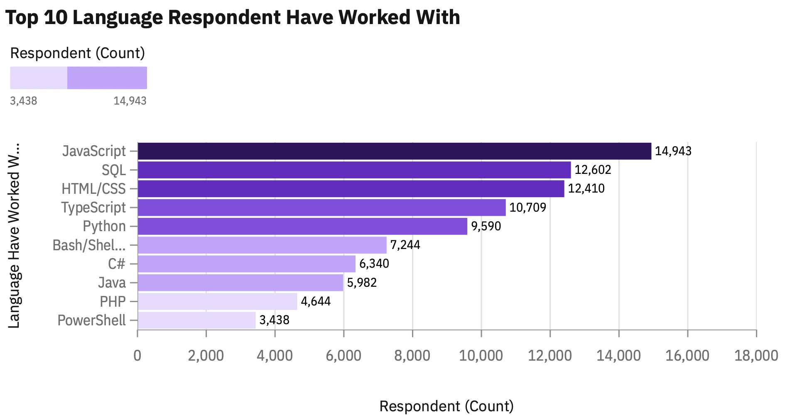
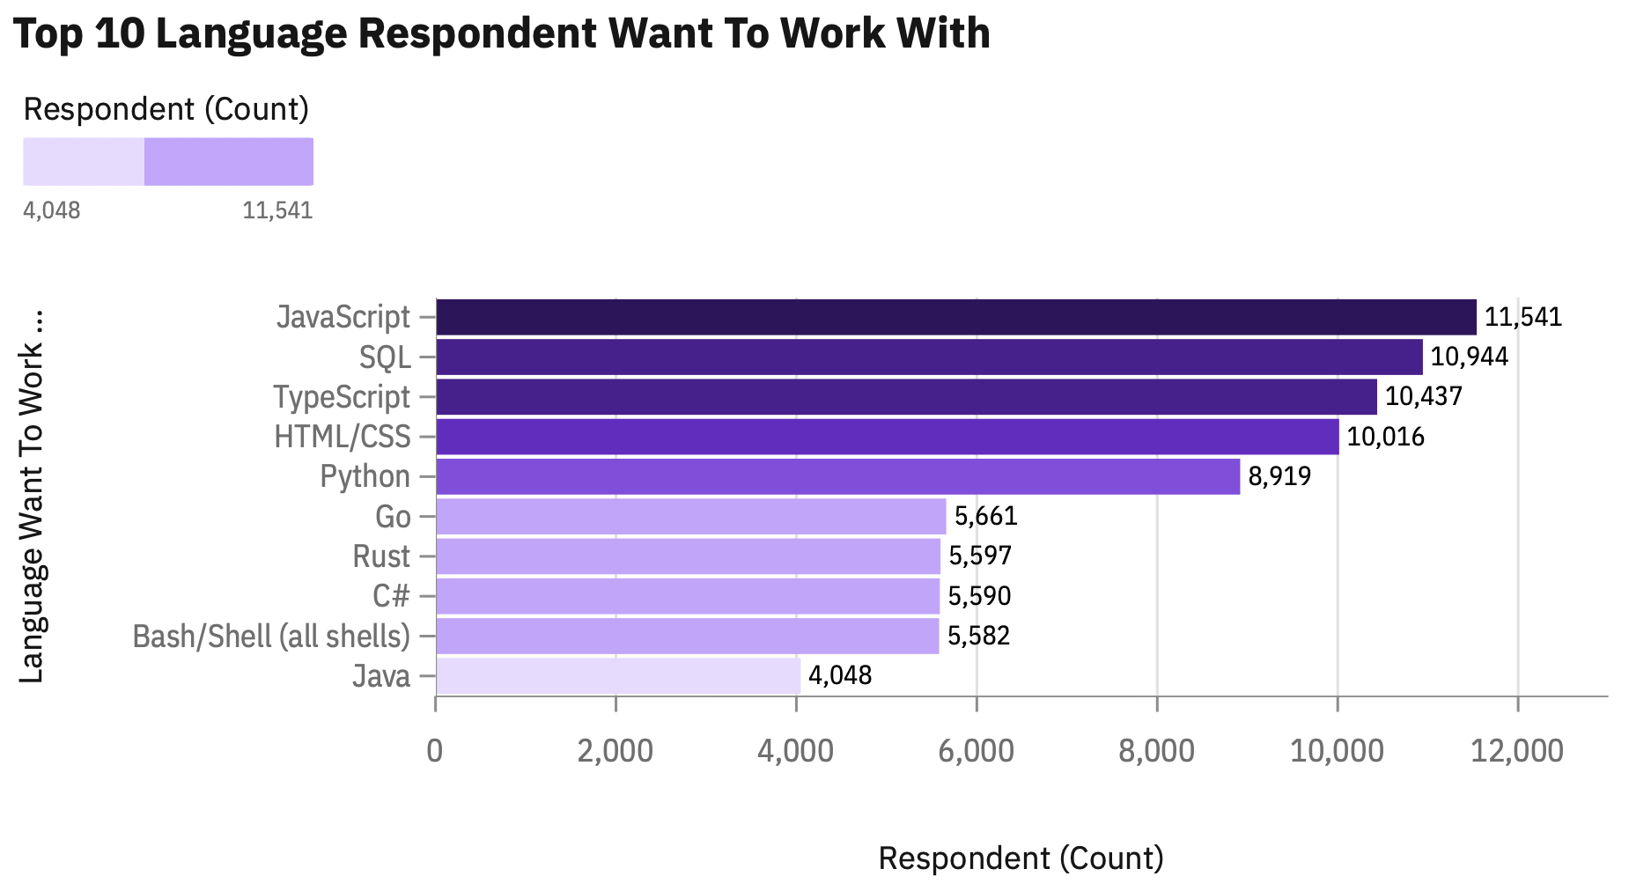
PROGRAMMING LANGUAGE TRENDS
Current Year
Next Year

Slide 8
PROGRAMMING LANGUAGE TRENDS
Findings
Java Script, SQL, Type Script, HTML, CSS, and Python are the top 5 languages ​​that are popularly used today and are expected to be used in the coming year, indicating continued strong interest in these languages.
There is a significant desire for less commonly used languages like Go and Rust, to use those language in the next year despite lower current usage
Implications
Training for the top 5 languages ​​can be continued and deepened considering their popularity until next year.
Training for less commonly used language (Go and Rust) can be initiated this year to prepare for its use next year.
PHP's performance is poor even though it is easy to use, so it does not support current technological developments and needs, so many developers are switching to other languages.

Slide 9
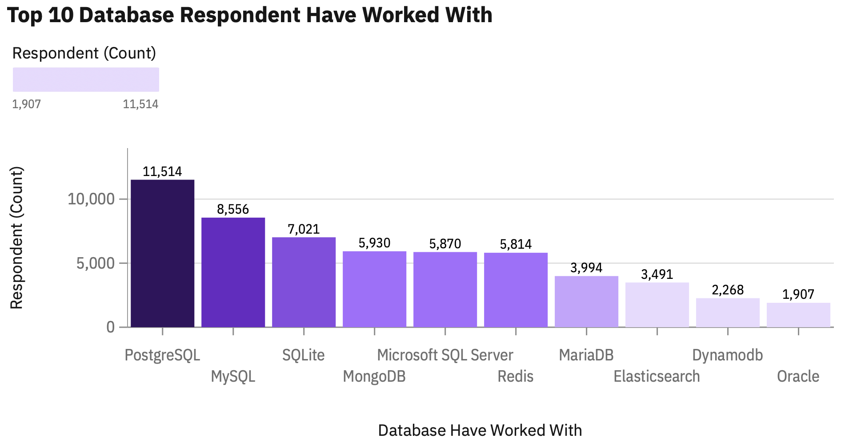
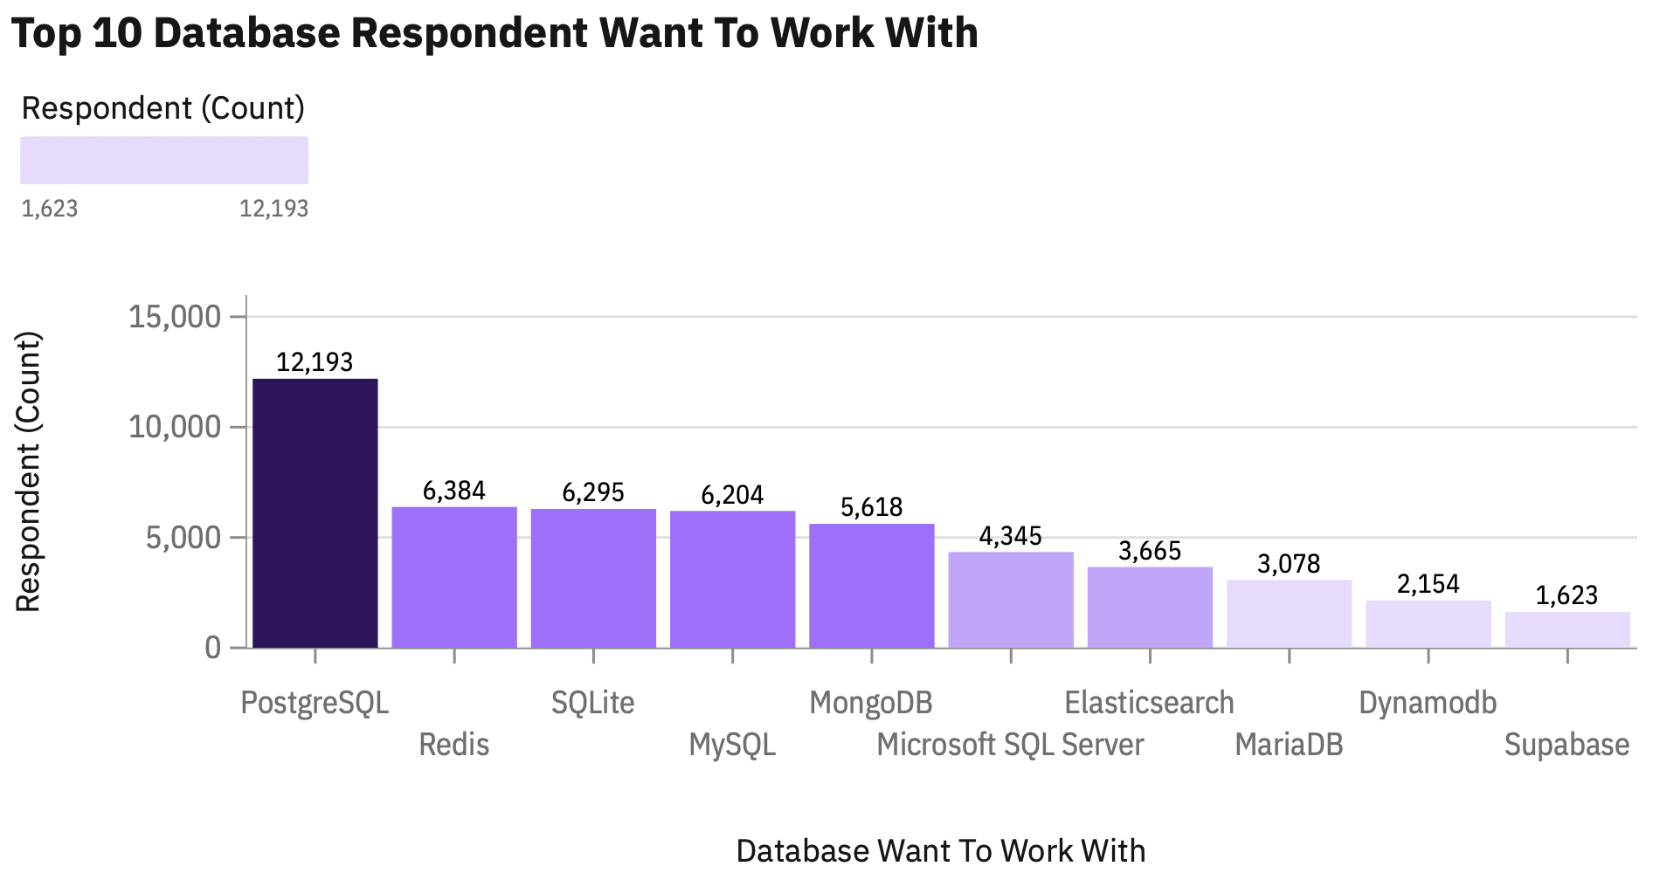
DATABASE TRENDS
Current Year
Next Year

Slide 10
DATABASE TRENDS
Findings
PostgreSQL, SQLite, MySQL are a database that will remain popular for next year.
Oracle, which was in the top 10 for the current year, is absent from the top 10 list for the next year, indicating declining interest.
Redis show significant increases in interest for the next year, moving up the rankings.
Implications
Training for PostgreSQL, SQLite, and MySQL can be continued and deepened considering their popularity until next year.
Shift investment from Oracle to PostgreSQL or MySQL because Oracle is paid database, even though both have good performance.
Redis stores data in device memory so it has faster performance even though the data is not permanent, so many developers are starting to be interested in using Redis as session storage.

Slide 11


DASHBOARD
Technology Trend Dashboard
Click here ☺

Slide 12
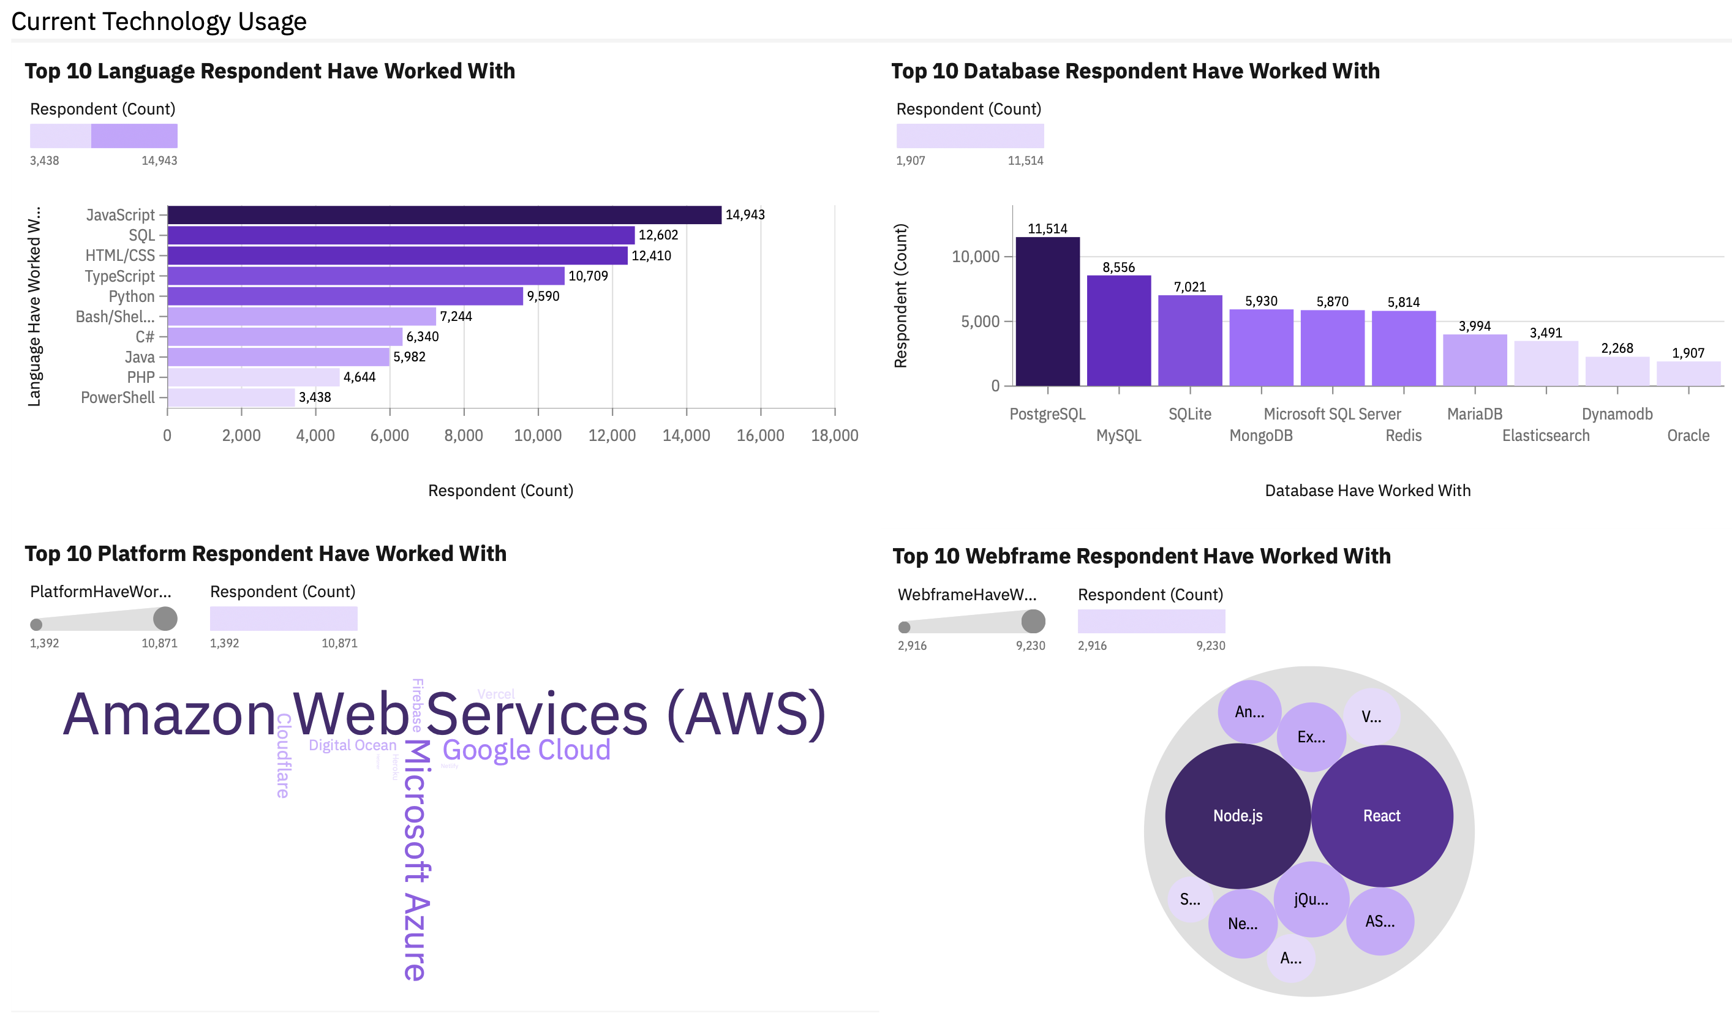
DASHBOARD TAB 1

Slide 13
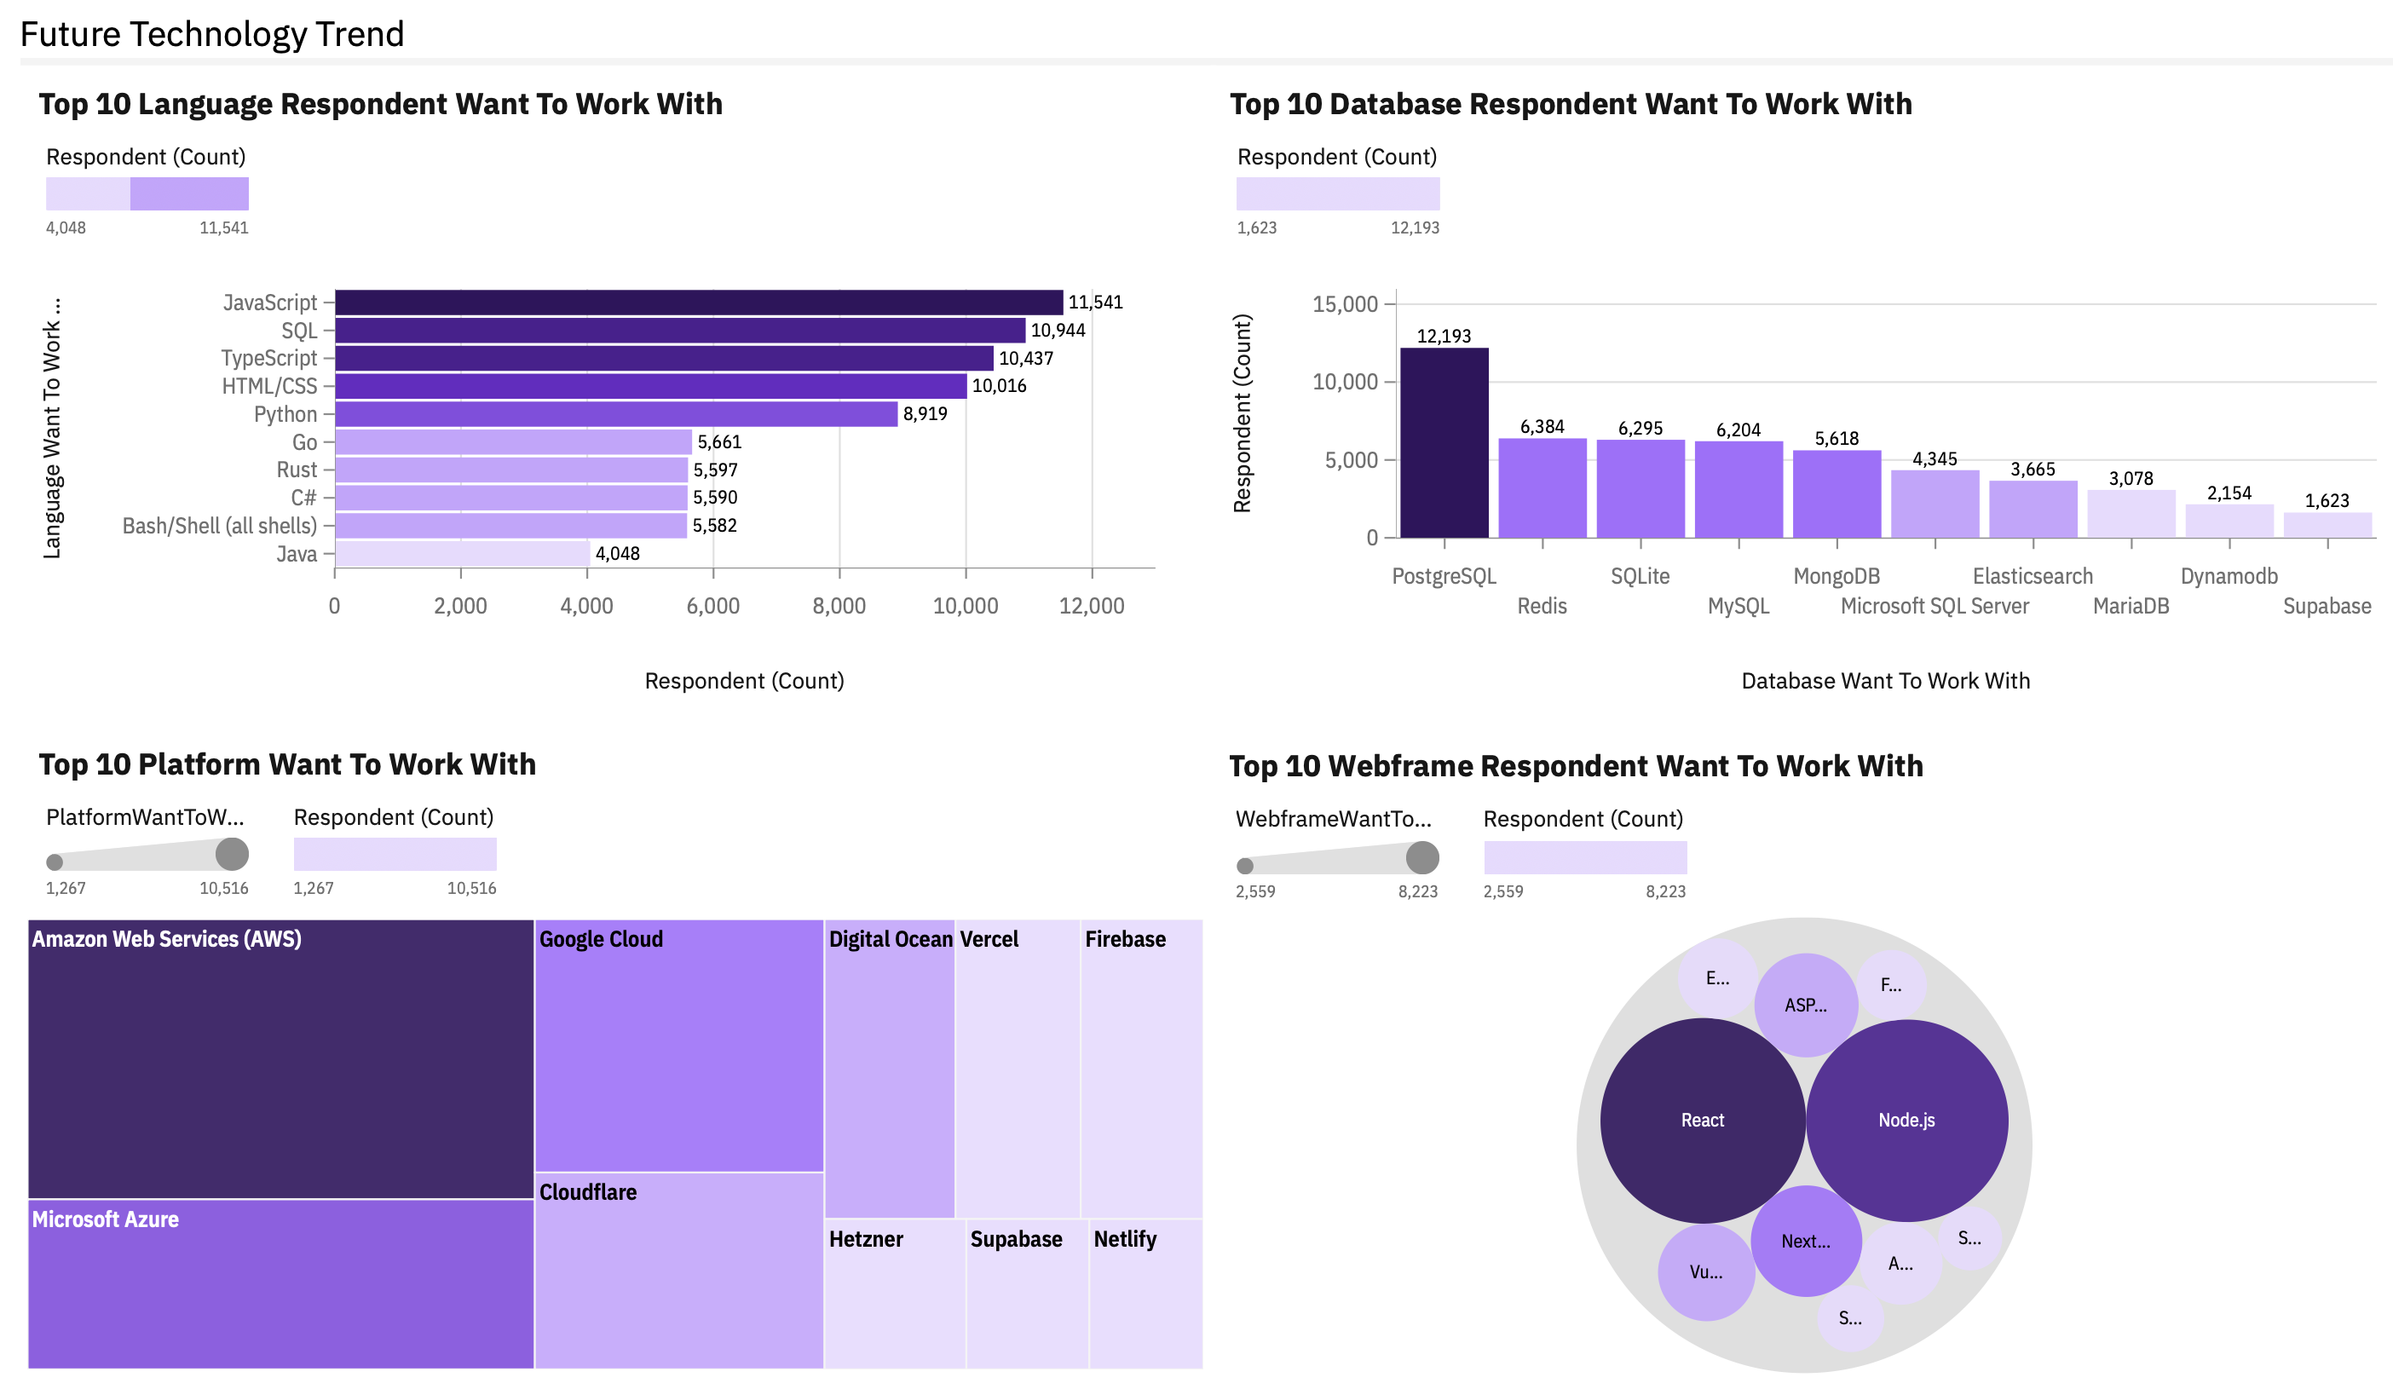
DASHBOARD TAB 2

Slide 14
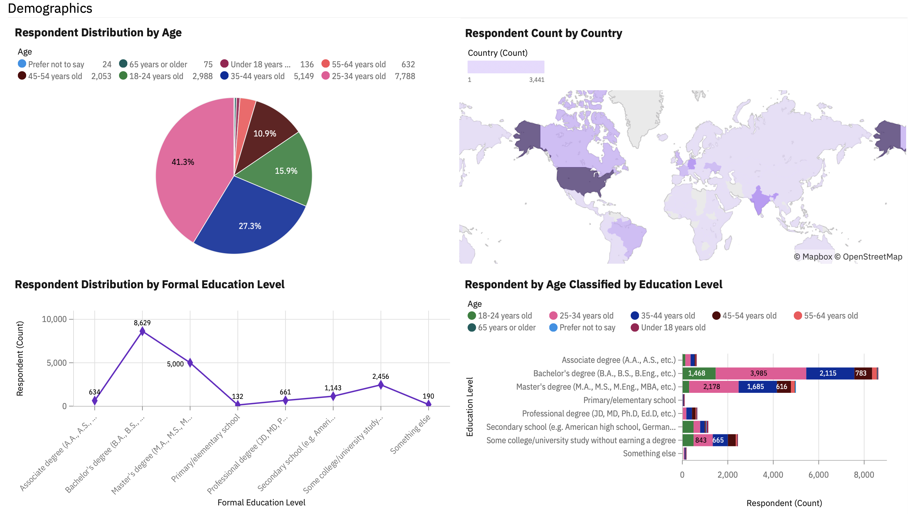
DASHBOARD TAB 3

Slide 15
DISCUSSION
Amazon Web Services (AWS) and Microsoft Azure are platform that continue to be popular for the next year.
Node.js and React are web frame that continue to be popular for the next year.
Respondents were dominated by developers with an age range of 25-34 years (41.3%) and followed by age range 35-44 years (27.3%).
Most of the respondents had a formal education as a Bachelor's degree and followed by a formal education as a Master’s degree, which indicates that this profession requires a good formal educational backbone.
Most of the respondents were from the USA and Europe. This is good information for HR team for the recruitment process related to developer needs.

Slide 16
OVERALL FINDINGS & IMPLICATIONS
Findings
Amazon Web Services (AWS) and Microsoft Azure are platform that continue to be popular for the next year.
Node.js and React are web frame that continue to be popular for the next year.
Developers with a Bachelor's degree educational background have the largest age group, while developers with a primary school educational background consist of the age group under 18 years.
Implications
Training for WAS, Microsoft Azure, Node.js, and React can be continued and deepened considering their popularity until next year.
Developers with a primary school education background and under the age of 18 years have great potential to develop very well if they continue to a higher level of education while still pursuing the developer profession.

Slide 17

CONCLUSION
Most technologies (languages, databases, platforms, web frameworks, tools, etc.) remain highly relevant for development in the coming year.
Data analysis shows that respondents were mostly aged 25-34 years old, with a formal education bachelor's degree, from the USA, and are full-stack developers.
Developer are looking for 3 main factors when choosing technologies: (1) faster and good performance, needed to support complex ecosystems, (2) provide a comprehensive suite of services for AI, compute, storage, databases, and networking, (3) has a free edition to reduce cost.

Slide 18
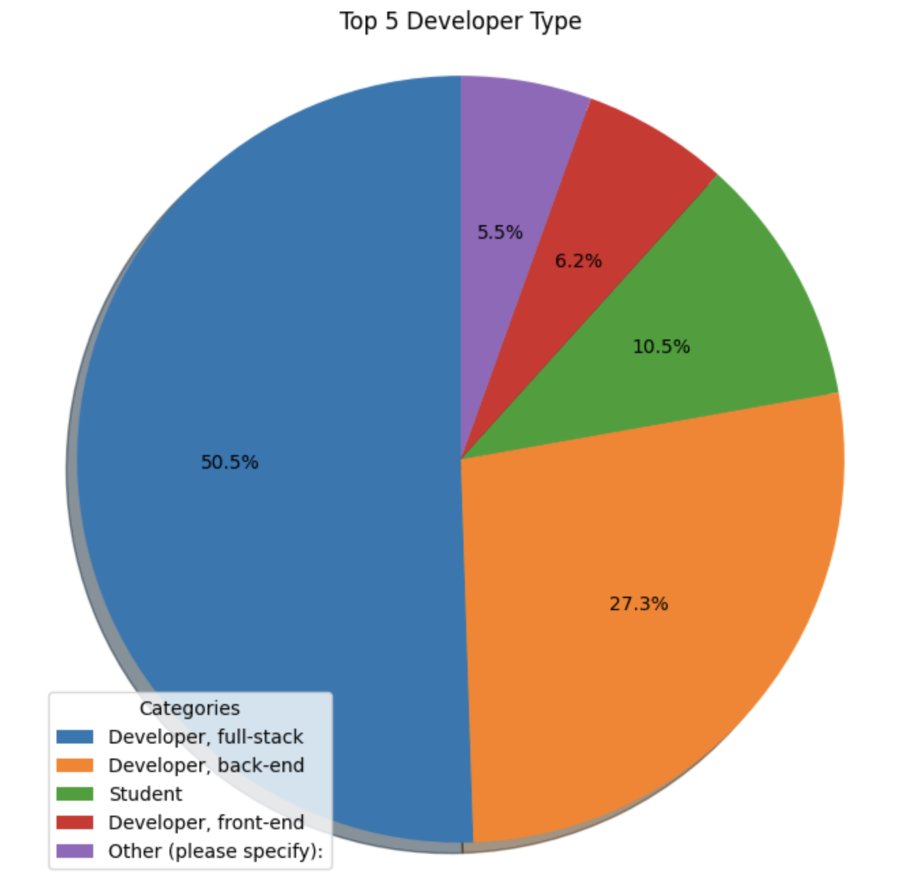

APPENDIX

Slide 19
JOB POSTINGS

Slide 20
POPULAR LANGUAGES

